Slide 1


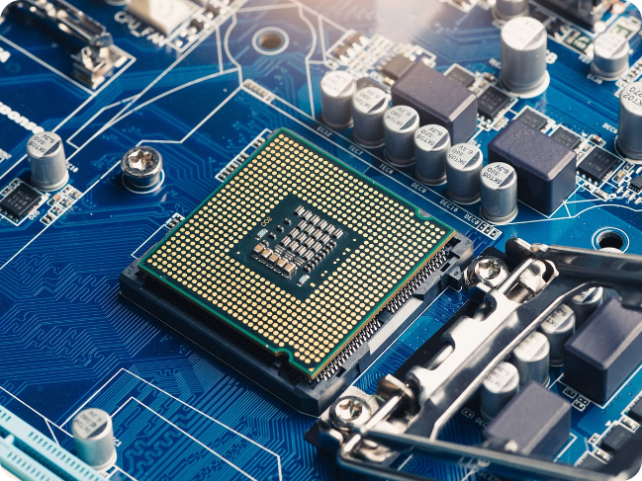
Introduction to CPU Scheduling
CPU scheduling is a fundamental concept in operating systems that determines the order in which processes are executed on the CPU. Efficient CPU scheduling is crucial for maximizing system throughput and ensuring fair resource allocation.
BY:
S.GRISHMA CHANDU(192210566)
A.DIVYAPRIYA(192210454)
K.SAI TEJA SREE(192210206)

Slide 2

Importance of CPU Scheduling
Increased Efficiency
Fair Resource Allocation
Responsiveness
Effective CPU scheduling can improve overall system performance by reducing idle time and maximizing utilization of the processor.
CPU scheduling algorithms ensure that all processes are given a fair share of the CPU, preventing any single process from monopolizing the system.
Proper scheduling can improve the responsiveness of interactive systems, ensuring that user requests are handled promptly.

Slide 3


Objectives of CPU Scheduling
1
Maximize CPU Utilization
2
Fairness
The scheduler should ensure that all processes are given a fair share of the CPU, based on their priorities or resource requirements.
CPU scheduling algorithms should aim to keep the CPU as busy as possible, avoiding idle time.
3
Minimizing Waiting Time
4
Minimizing Response Time
The scheduler should strive to minimize the time a process spends waiting in the ready queue before being executed.
For interactive systems, the scheduler should minimize the time between when a user submits a request and when the system responds.

Slide 4




Challenges Faced
Starvation
Lower priority tasks may never get a chance to execute.
Overhead
Scheduling algorithms can add processing overhead, reducing overall system performance.
Predictability
It can be challenging to accurately predict task execution times for optimal scheduling.

Slide 5
CPU Scheduling Algorithms
Pre-emptive
Non-preemptive
Hybrid
Algorithms that can interrupt a running process and switch to a different process, such as Priority Scheduling and Round-Robin.
Algorithms that allow a process to run until completion, such as First-Come, First-Served and Shortest-Job-First.
Algorithms that combine aspects of both pre-emptive and non-preemptive scheduling, such as Multilevel Feedback Queue.

Slide 6


First-Come, First-Served (FCFS) Scheduling
1
Process Arrival
Processes are added to the ready queue in the order they arrive.
2
Queue Ordering
Processes are executed in the same order they were added to the queue.
3
Execution
Each process runs to completion before the next process is executed.

Slide 7

Shortest-Job-First (SJF) Scheduling
Execution
Process Arrival
The process with the shortest estimated burst time is executed until completion.
Processes are added to the ready queue as they arrive.
1
2
3
Queue Ordering
Processes are executed in order of their estimated burst time, from shortest to longest.

Slide 8

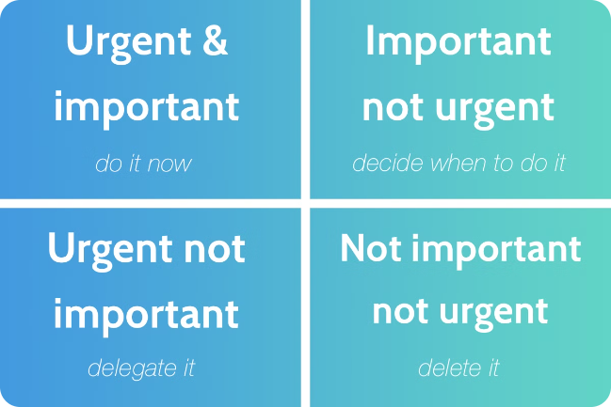
Priority Scheduling
1
Process Arrival
Processes are added to the ready queue as they arrive.
2
Queue Ordering
Processes are executed in order of their assigned priority, from highest to lowest.
3
Execution
The process with the highest priority is executed until completion or preemption.

Slide 9

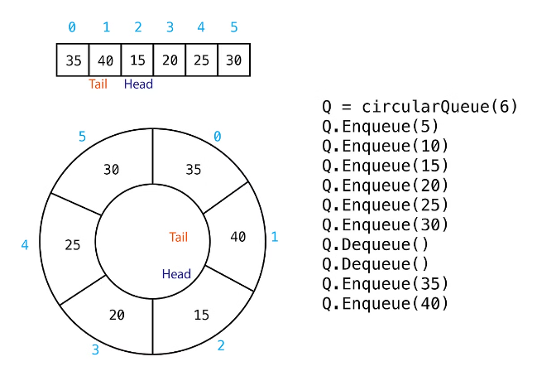
Round-Robin (RR) Scheduling
1
Process Arrival
Processes are added to the ready queue as they arrive.
2
Queue Ordering
Processes are executed in a circular order, with a predefined time slice for each process.
3
Execution
Each process is executed for the time slice, and then the scheduler moves to the next process in the queue.

Slide 10
Comparison of CPU Scheduling Algorithms
FCFS
SJF
Priority
RR
Simple to implement, but can lead to long wait times for some tasks.
Optimal for minimizing average waiting time, but can lead to starvation.
Ensures important tasks are executed first, but can also lead to starvation.
Provides fair access to the CPU, but can result in higher average waiting time.

Slide 11

Future Considerations
Multicore Processors
Real-time Systems
Energy Efficiency
Scheduling algorithms must adapt to take advantage of parallel processing capabilities in modern CPUs.
Scheduling in real-time systems must ensure that critical tasks meet their deadlines, even in the face of varying workloads.
Scheduling algorithms should consider energy consumption and minimize power usage, especially in mobile and embedded systems.

Slide 12


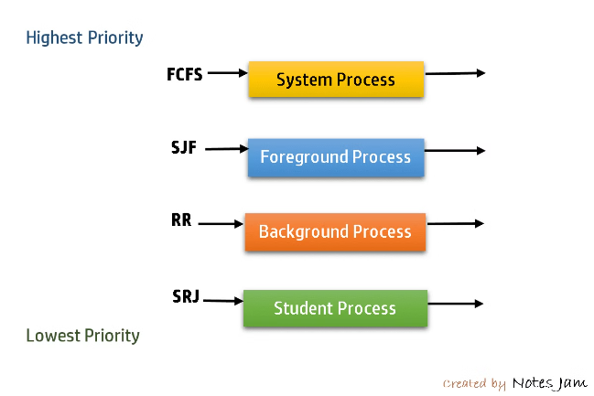


Conclusion
Efficient Scheduling
Effective CPU scheduling is crucial for optimizing system performance and ensuring fair resource allocation.
Variety of Algorithms
Different scheduling algorithms offer various trade-offs in terms of fairness, response time, and resource utilization.
Ongoing Challenges
As hardware and system requirements evolve, CPU scheduling algorithms must adapt to meet new demands and constraints.

